Slide 1
Cyber Security – 22MCA3053
Elective
Slides Prepared by Shivakumara Tuppada

Slide 2
Module-4 Topics to be discussed:
Intrusion Detection and Prevention:
Intrusion
Physical Theft
Abuse of Privileges
Unauthorized access by outsiders
Malware Infection
Intrusion detection and prevention techniques
Network Based Intrusion Detection Systems
Host Based Intrusion Prevention Systems

Slide 3

An adversary gains physical access to a system or device through theft of the item. Possession of a system or device enables a number of unique attacks to be executed and often provides the adversary with an extended timeframe for which to perform an attack.
Physical Theft
What is an example of physical theft?
The theft of magnetic storage media (tapes, hard drives), optical storage media such as CDs (Compact Discs), DVDs (Digital Versatile Discs) or electronics such as USB sticks (Universal Serial Bus), used for security copies, main storage or backups, is very common and enables the theft of large quantities of data.

Slide 4
What is the relationship between physical security and cybersecurity?
Together, cyber and physical assets represent a significant amount of risk to physical security and cybersecurity – each can be targeted, separately or simultaneously, to result in compromised systems and/or infrastructure.
How can we prevent physical theft?
Do not leave your devices unattended in public areas.
Store devices in secure areas such as a locked desk or office.
Lock publicly-accessible non-portable devices to solid fixtures such as walls or tables to prevent theft.
Do not leave physical documents containing sensitive University information in public areas.

Slide 5
Privilege abuse is the fraudulent practice of using an account with additional privileges, also known as a privileged account, to access, exploit, or damage confidential business entities.
Abuse of Privileges
Abuse of privileged information- This involves the use, by a public servant ofprivileged information and knowledge that a public servant possesses as a result of his/ her office to provide unfair advantage to another person or entity to obtain a benefit.

Slide 6
Examples of privileged access used by humans:
Negative impacts on privilege abuse by employees:
Without a security protocol in place, employees can easily gain access to sensitive information and increase the risk of data being leaked. This can happen by accident, because of sloppy or lacking privileged access management (PAM) or through the interference of a cyber adversary.
The phrase “Keys to the IT Kingdom” is often used when referring to the privileged nature of some administrator accounts and systems. Local administrative account: This account is located on an endpoint or workstation and uses a combination of a username and password.

Slide 7
Privilege escalation is a type of network attack used to gain unauthorized access to systems within a security perimeter.
Understanding Privilege Escalation
Attackers start by finding weak points in an organization’s defenses and gaining access to a system. In many cases that first point of penetration will not grant attackers with the level of access or data they need. They will then attempt privilege escalation to gain more permissions or obtain access to additional, more sensitive systems.

Slide 8
Malware can use known software vulnerabilities to infect your PC. A vulnerability is like a hole in your software that can give malware access to your PC. When you go to a website, it can try to use vulnerabilities in your web browser to infect your PC with malware.
Malware Infection:
What causes malware infection?
Malware can get onto your device when you open or download attachments or files, or visit a scammy website. Your device might get infected with malware through: downloading free stuff like illegal downloads of popular movies, TV shows, or games. downloading content available on file-sharing sites.

Slide 9
If you notice your homepage changed or you have new toolbars, extensions, or plugins installed, then you might have some sort of malware infection. Causes vary, but this usually means you clicked on that “congratulations” pop-up, which downloaded some unwanted software.
How do you know if you have a malware infection?

Slide 10
Introduction
An Intrusion Detection system (IDS)
  Detects attacks as soon as possible and takes appropriate action.
  Does not usually take preventive measures when an attack is detected.
  It is a reactive rather than a pro-active agent.
  It plays a role of informant rather than a police officer.

Slide 11
Introduction
The most popular way to detect intrusions has been using the audit data generated by the operating system.
  An audit trail is a record of activities on a system that are logged to a file in chronologically sorted order.
  Audit trails are particularly useful in establishing the guilt attackers.
  They are often the only way to detect unauthorized but subversive user activity.

Slide 12
Introduction
Eugene Spafford reports:
  Information theft is up over 250% in the last 5 years.
  99% of all major companies report at least one major incident.
  Telecom and computer fraud totaled $10 billion in the US alone.
Since it seems obvious that we cannot prevent subversion, we should at least try to detect it and prevent similar attacks in future.

Slide 13
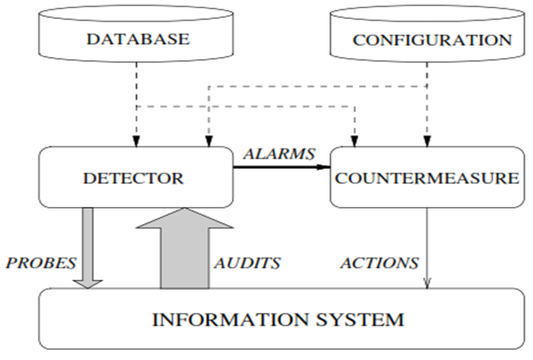
Very simple intrusion-detection system
Source: H. Debar, An Introduction to Intrusion-Detection System, IBM Research, Zurich Research Lab

Slide 14
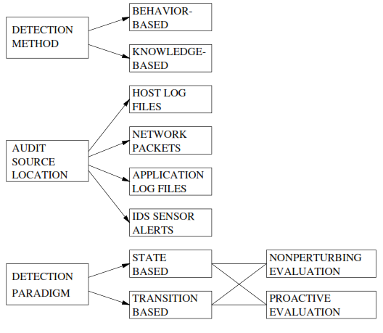
Taxonomy
Source: H. Debar, An Introduction to Intrusion-Detection System, IBM Research, Zurich Research Lab

Slide 15
Introduction
Secure information transmission is very important in the present scenario for healthy reputation and financial status.
Many intrusion detection systems are based on either signature information or anomaly that generate false detections.
A hybrid IDS proposed which uses the signature and anomaly information together can offer better detection.

Slide 16
Objectives
Understand the concept of IDS/IPS and the two major categorizations:
  based on either signature information or
  anomaly that generate false detections.
Discussion on proposed hybrid IDS
Be able to write a snort rule when given the signature and other configuration info

Slide 17
Definitions
Risk: Accidental exposure of information, or violation of operations integrity due to the malfunction of hardware or incomplete or incorrect software design.
Vulnerability: A known or suspected flaw in the h/w or s/w or operation of a system that exposes the system to penetration or its information to accidental disclosure.
Attack: A specific formulation or execution of a plan to carry out a threat.
Penetration: A successful attack.

Slide 18
Definitions
Intrusion
  A set of actions aimed to compromise the security goals, namely
    Integrity, confidentiality, or availability, of a computing and networking resource
Intrusion detection
  The process of identifying and responding to intrusion activities
Intrusion prevention
  Extension of ID with exercises of access control to protect computers from exploitation

Slide 19
Elements of Intrusion Detection
Primary assumptions:
  System activities are observable
  Normal and intrusive activities have distinct evidence
Components of intrusion detection systems:
  From an algorithmic perspective:
    Features - capture intrusion evidences
    Models - piece evidences together
  From a system architecture perspective:
    Various components: audit data processor, knowledge base, decision engine, alarm generation and responses

Slide 20

Components of Intrusion Detection System
Audit Records
system activities are observable
Audit Data Preprocessor
Activity Data
Detection
Models
normal and intrusive activities have distinct evidence
Detection Engine
Alarms
Action/Report
Decision
Table
Decision Engine

Slide 21
Intrusion Detection Approaches
Modeling
  Features: evidences extracted from audit data
  Analysis approach: piecing the evidences together
    Misuse detection ( signature-based)
    Anomaly detection ( statistical-based)
Deployment: Network-based or Host-based
  Network based: monitor network traffic
  Host based: monitor computer processes
Notes:
Need “both” on all these.

Slide 22
Misuse Detection
pattern matching
Intrusion Patterns:
    Sequences of system calls, patterns of network traffic, etc.
intrusion
activities
Example: if (traffic contains “x90+deZ^\r\n]{30}”) then “attack detected”
Advantage: Mostly accurate. But problems?
Can’t detect new attacks

Slide 23
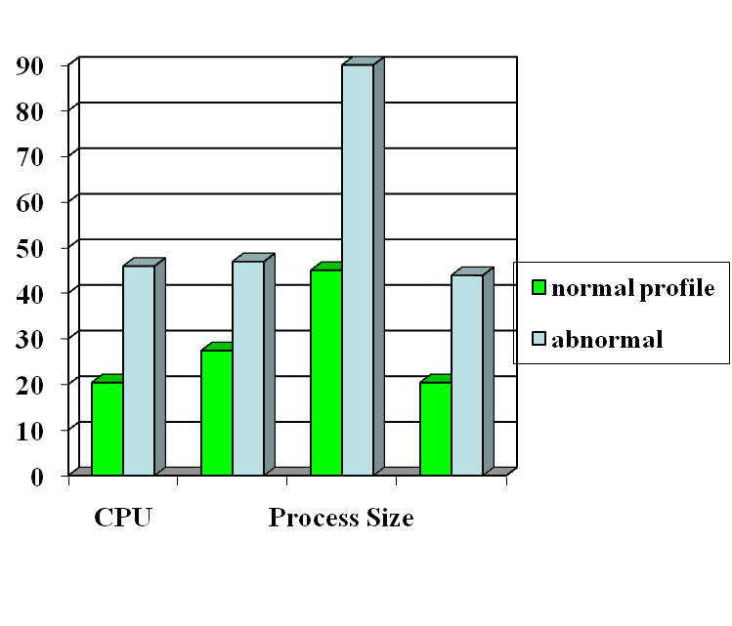

Anomaly Detection
probable intrusion
activity measures
Define a profile describing
“normal” behavior, then
detects deviations. Thus can detect potential new attacks.
Any problem ?
Relatively high false positive rates
Anomalies can just be new normal activities.
Anomalies caused by other element faults
  E.g., router failure or misconfiguration, P2P misconfig
Which method will detect DDoS SYN flooding ?
Notes:
The two axis not shown are IO and page fault.

Slide 24
Host-Based IDSs
Use OS auditing and monitoring/analysis mechanisms to find malware
  Can execute full static and dynamic analysis of a program
    Monitor shell commands and system calls executed by user applications and system programs
  Has the most comprehensive program info for detection, thus accurate
Problems:
  If attacker takes over machine, can tamper with IDS binaries and modify audit logs
  User dependent: install/update IDS on all user machines!
  Only local view of the attack

Slide 25
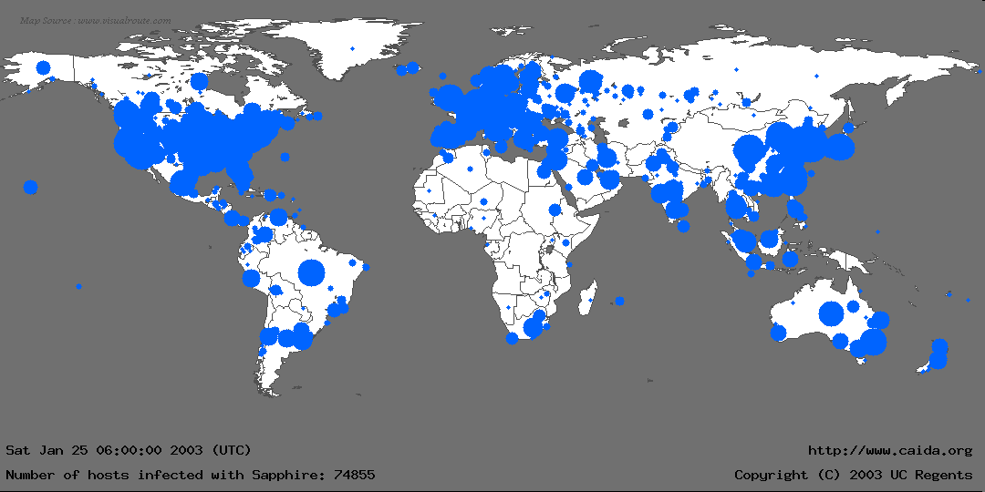
The Spread Worm: Sapphire/Slammer Worms
Source: https://www.caida.org/publications/papers/2003/sapphire/sapphire.html
Notes:
In the first 30 minutes of Sapphire’s spread, we recorded nearly 75,000 unique infections. As we will detail later, most of these infections actually occurred within 10 minutes.
This graphic is more for effect rather than technical detail: We couldn’t determine a detailed location for all infections, and the diameter of each circle is proportional to the lg() of the number of infections, underrepresenting larger infections. Nevertheless, it gives a good feel for where Sapphire spread.
We monitored the spread using several “Network Telescopes”, address ranges where we had sampled or complete packet traces at single sources. We also used the D-shield distributed intrusion detection system to determine IPs of infected machines, but we couldn’t use this data for calculating the scanning rate.

Slide 26


Network Based IDSs
Internet
Gateway routers
Our network
Host based
detection
At the early stage of the worm, only limited worm samples.
Host based sensors can only cover limited IP space, which has scalability issues.
  Might not be able to detect the worm in its early stage.

Slide 27
Network IDSs
Deploying sensors at strategic locations
  For example, Packet sniffing via tcpdump at routers
Inspecting network traffic
  Watch for violations of protocols and unusual connection patterns
  Look into the packet payload for malicious code
Limitations
  Cannot execute the payload or do any code analysis !
  Even DPI gives limited application-level semantic information
  Record and process huge amount of traffic
  May be easily defeated by encryption, but can be mitigated with encryption only at the gateway/proxy
Notes:
Problems: mainly accuracy

Slide 28
Host-based vs. Network-based IDS
Give an attack that can only be detected by host-based IDS but not network-based IDS
Can you give an example only be detected by network-based IDS but not host-based IDS ?
Notes:
For the first: a unknown malware
For the second: botnet scanning or worm propagation

Slide 29
Key Metrics of IDS/IPS
Algorithm
  Alarm: A; Intrusion: I
  Detection (true alarm) rate: P(A|I)
    False negative rate P(¬A|I)
  False alarm (aka, false positive) rate: P(A|¬I)
    True negative rate P(¬A|¬I)
Architecture
  Throughput of NIDS, targeting 10s of Gbps
    E.g., 32 nsec for 40 byte TCP SYN packet
  Resilient to attacks

Slide 30
Architecture of Network IDS
Signature matching
(& protocol parsing when needed)
Protocol identification
TCP reassembly
Packet capture libpcap
Packet stream

Slide 31
Firewall/Net IPS VS Net IDS
Firewall/IPS
  Active filtering
  Fail-close
Network IDS
  Passive monitoring
  Fail-open
IDS
FW
Notes:
Protection is not free/cheap. For example, an intrusion detection system (IDS) needs to analyze each packet. This requires a lot of computing power, usually a dedicated high-end workstation. If the IDS is real-time then its response time must be short.
When there is insufficient resources, some protection mechanisms will simply not let data in (fail-close). For example, a firewall, which filters each packet, will simply drop packets when it is overloaded. The dropped packet will not be able to reach beyond the firewall into the internal network. The user experience may not be a happy one because of data loss. However, other protection mechanisms will check/analyze as much as they can but will effectively let all data (fail-open) when there is insufficient resources. For example, an IDS, which simply copies a packet and analyzes it (while the packet continues to reach its target), may only be able to check a packet after a lengthy delay when it is overloaded, letting the packet to complete its potentially malicious actions.
When assessing the protection mechanisms, we will develop models and evaluate under what conditions they will fail-close or fail-open.

Slide 32
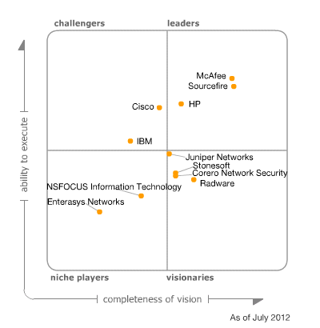
Gartner Magic Quadrant for IPS
Ability to Execute
Product/Service
Overall Viability (Business Unit, Financial, Strategy, Organization)
Sales Execution/Pricing
Market Responsiveness and Track Record
Marketing Execution
Customer Experience
Operations
Completeness of Vision
Market Understanding
Marketing Strategy
Sales Strategy
Offering (Product) Strategy
Business Model
Vertical/Industry Strategy
Innovation
Geographic Strategy
Source: http://www.gartner.com/technology/reprints.do?id=1-1B9PW2W&ct=120706&st=sb
Notes:
http://www.gartner.com/technology/reprints.do?id=1-1B9PW2W&ct=120706&st=sb

Slide 33
Problems with Current IDSs
Inaccuracy for exploit based signatures
Cannot recognize unknown anomalies/intrusions
Cannot provide quality info for forensics or situational-aware analysis
  Hard to differentiate malicious events with unintentional anomalies
    Anomalies can be caused by network element faults, e.g., router misconfiguration, link failures, etc., or application (such as P2P) misconfiguration
  Cannot tell the situational-aware info: attack scope/target/strategy, attacker (botnet) size, etc.

Slide 34
Limitations of Exploit Based Signature
Signature: 10.*01
1010101
Internet
Traffic Filtering
10111101
X
Our network
X
11111100
00010111
Polymorphism!
Polymorphic worm might not have exact exploit based signature

Slide 35



Vulnerability Signature
Vulnerability
signature traffic filtering
Internet
X
X
Our network
X
X
Vulnerability
Work for polymorphic worms
Work for all the worms which target the
same vulnerability

Slide 36
Example of Vulnerability Signatures
At least 75% vulnerabilities are due to buffer overflow
Sample vulnerability signature
Field length corresponding to vulnerable buffer > certain threshold
Intrinsic to buffer overflow vulnerability and hard to evade
Overflow!
Protocol message
Vulnerable buffer

Slide 37
Related Tools for Network IDS (I)
While not an element of Snort, wireshark (used to called Ethereal) is the best open source GUI-based packet viewer
www.wireshark.org offers:
  Support for various OS: windows, Mac OS.
Included in standard packages of many different versions of Linux and UNIX
For both wired and wireless networks

Slide 38
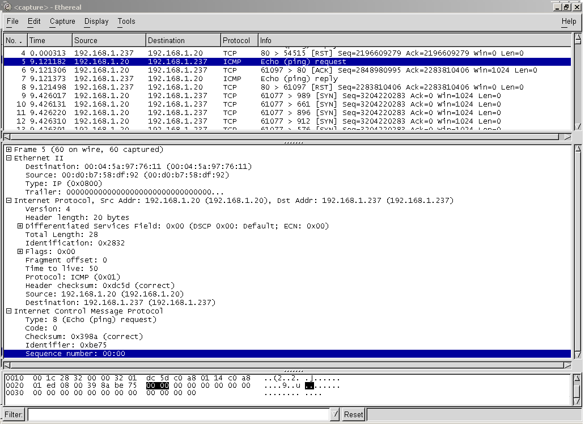

Slide 39
Related Tools for Network IDS (II)
Also not an element of Snort, tcpdump is a well-established Command Line Interface (CLI) packet capture tool
  www.tcpdump.org offers UNIX source
  http://www.winpcap.org/windump/ offers windump, a Windows port of tcpdump

Slide 40
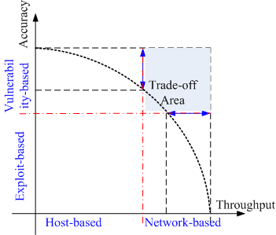
Next Generation IDSs
Vulnerability-based
Adaptive
  - Automatically detect & generate signatures for zero-day attacks
Scenario-based for forensics and being situational-aware
  Correlate (multiple sources of) audit data and attack information

Slide 41
References
Dr. K. V. Arya, Multimedia & Information Security Research Group, ABV-Indian Institute of Information Technology & Management Gwalior, India,
https://www.malwarebytes.com/malware#:~:text=If%20you%20notice%20your%20homepage,which%20downloaded%20some%20unwanted%20software.
https://www.google.com/search?rlz=1C1OKWM_enIN930IN930&q=What+causes+malware+infection%3F&sa=X&ved=2ahUKEwi9gPf35qr9AhUDCLcAHcDRD-0Qzmd6BAgXEAU
https://support.microsoft.com/en-us/windows/how-malware-can-infect-your-pc-872bf025-623d-735d-1033-ea4d456fb76b#:~:text=Malware%20can%20use%20known%20software,infect%20your%20PC%20with%20malware.

